Slide 1

DriverPass System Analysis
Milton Francisco

Slide 2

System Requirements
Functional Requirements
System allows user to register individually.
System tracks and logs all user progress while using the app.
Nonfunctional Requirements
System is a cloud-based web app that loads data in under 2 seconds.
System is accessible on major operating systems.
Notes:
These are only a few of the requirements that we determined for your DriverPass system. We wanted to highlight a few of the key aspects mentioned in our interviews.
Allowing the customer to register themselves individually will empower the user and remove tedious aspects for your staff.
Additionally, tracking user progress will provide the customer with useful information and can provide the company great analytics to determine if a part of the application can be improved.
The nonfunctional requirements highlight the necessary requirements for this app to operate as intended. This app will be cloud-based, which removes the burden of responsibility for hardware from your company.
Along with that, ensuring this system is accessible will provide the structure to ensure a broad userbase, further increasing revenue.

Slide 3
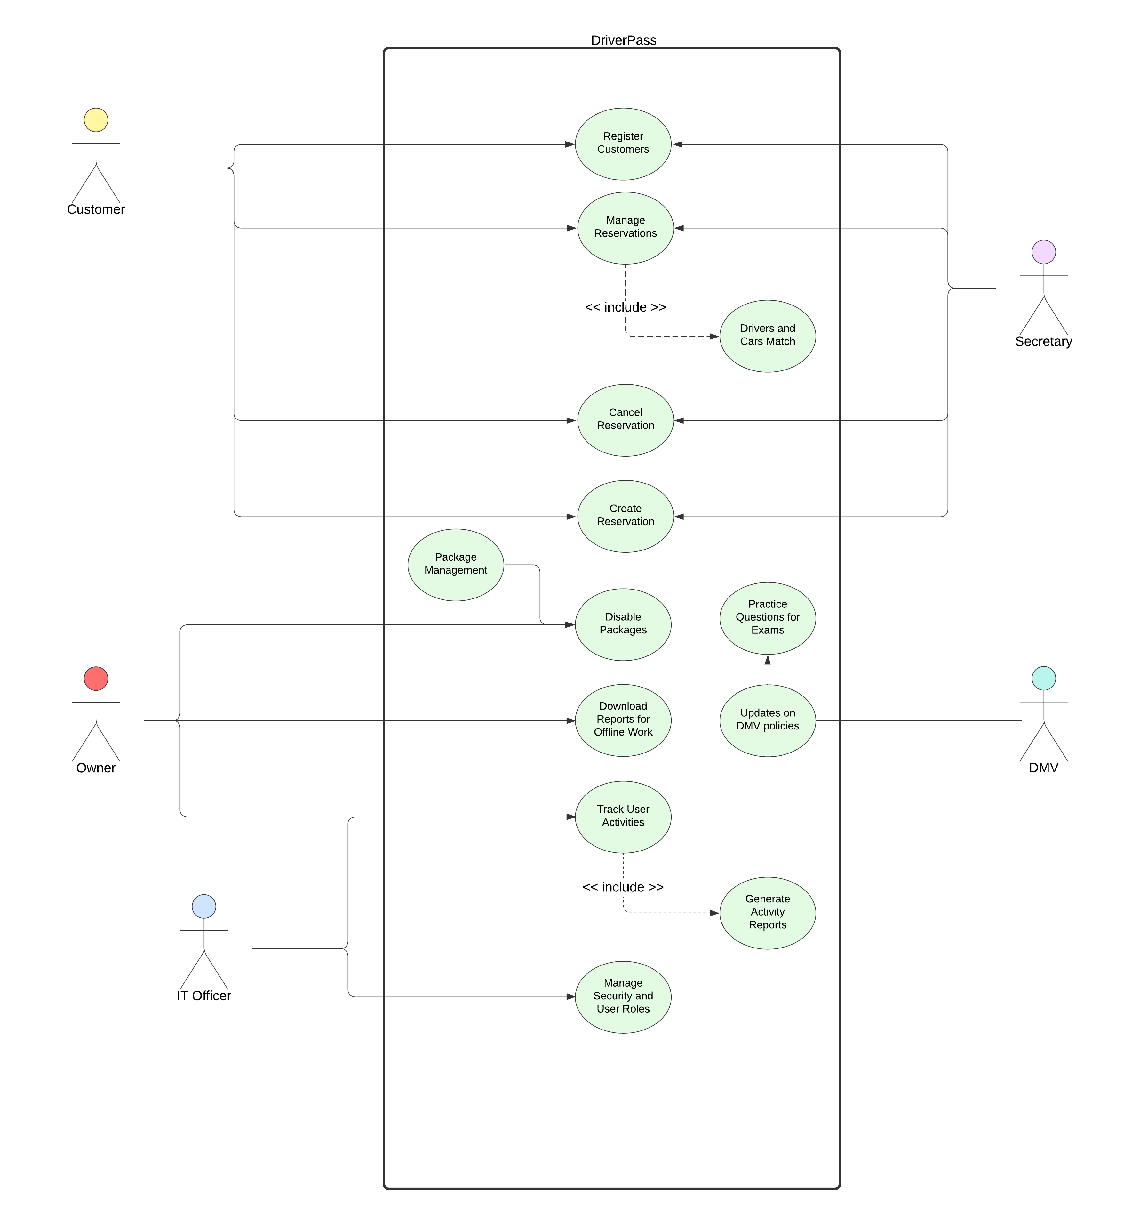
Use Case Diagram
Notes:
In this diagram, there are 5 different actors. Some actors share use cases to help consolidate the system. In this diagram, a use case describes an action an actor could take.
For example, the customer will have the option to self-manage their own reservations, but can also call the secretary to do much of the same functionality.
This differs from the secretary, who can do these processes for all of the customers.
Some actors are separate from others, as their access will be different. For example, the Owner and IT Officer have separate roles that allows them elevated access.
The Owner requested specific functionality, which is included in his use cases.

Slide 4
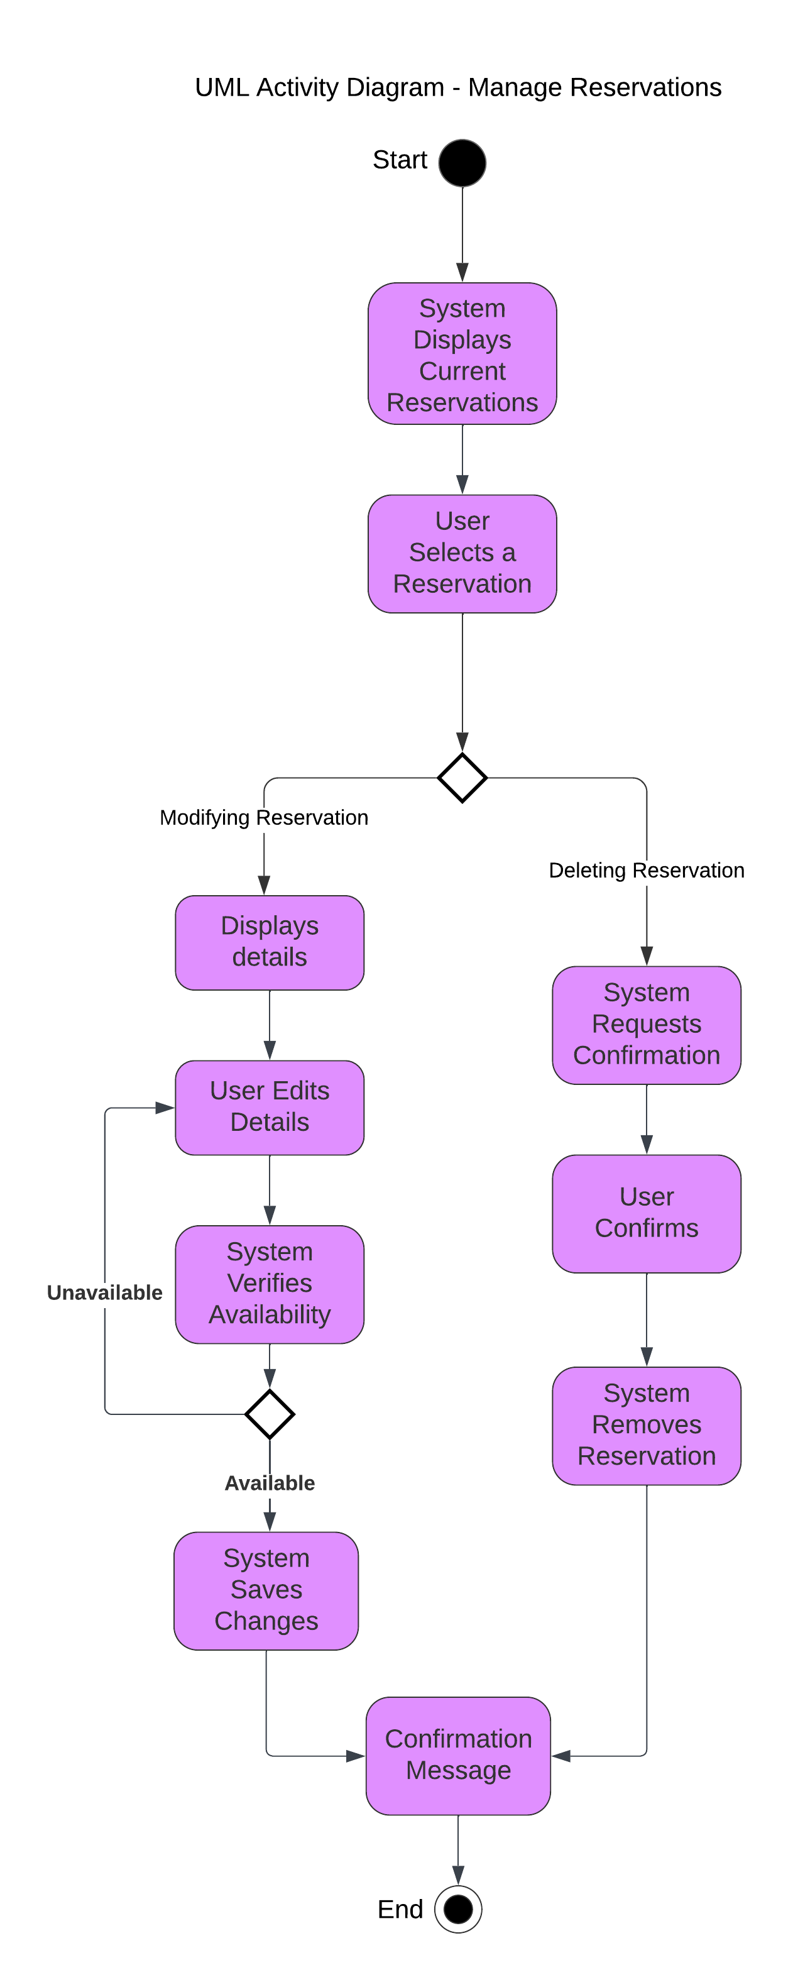
Activity Diagram
Notes:
This diagram shows the general activity of the ‘Manage Reservations’ use case.
When the user selects this option, the system shows their current reservations. The user can then find the reservation they need to change, and select it.
After selecting the reservation, they have 2 options. They can either modify it, or delete it.
In the modify branch, it displays the details and provides an area where the user can edit the necessary aspect. After the user has edited the reservation, the system verifies that there will be a driver and a car available for the new time or day. If it is unsuccessful, this process repeats until the user inputs an acceptable time and day. Once the changes are verified and accepted, the system saves them and the user receives confirmation that the changes were successful.
In the delete branch, less information transfer has to occur, so the process is slightly more simple. The system verifies with the user that they want to delete the reservation. This keeps users from accidentally deleting reservations. After the user confirms, the system removes the reservation and the user receives a confirmation message.
This shows the general process of how an interaction with this use case can be performed. Since the functionality is in the user’s control, it provides autonomy and removes that burden from your company.

Slide 5
Security
System requires a username and secure password.
Data exchange requires encryption.
Accounts will lock after 4 unsuccessful login attempts.
Personal Data is stored encrypted to prevent unauthorized access.
Notes:
When designing this system, we pursued a design that revolved around security. By ensuring users have unique usernames and passwords with stringent requirements, we enhanced security.
Additionally, when data exchange occurs, the data will be encrypted to prevent any nefarious individuals from obtaining sensitive data. Moreover, personal data is stored encrypted so even if an attack were to occur, the attackers would not obtain useful information.
Finally, to prevent brute force attacks, enabling an account lock after 4 unsuccessful login attempts, can ensure users are protected.

Slide 6
System Limitations
Customization – Restricts user’s ability to tailor the site to their preference.
Budget Constraints – If features are too excessive.
Notes:
Overall this system is solid. That said, there are areas that could use improvement, but simply cannot fit into our envelope.
One aspect is customization. Users will not be able to customize their experience, as the layout has already been designed, which could frustrate some individuals.
Additionally, as the project progresses, if a feature will take too long, it could cause budget conflicts that require the feature to be reduced or removed.
These limitations are not detrimental, and could only affect a small number of users, catering to a larger audience in an effort to increase revenue for your business.

